Slide 1





Your Menu. One Scan Away.
A modern digital menu that makes browsing effortless for diners and friction-free to manage for your hospitality business.

Slide 2


When Menus Change, Hassle Follows
Realities of Printed Menus
The Operational Burden
New Price? A printed menu doesn't update itself. Sticking labels or crossing out numbers ruins the venue's presentation.
Special Offer? Temporary weekend specials shouldn't create permanent operational headaches or wasted stock.
The Core Truth: Your kitchen and prices change regularly. Your customers shouldn't have to deal with outdated menus.
New Item? Adding just one seasonal dish can mean throwing away dozens of cards and paying for a full reprint run.

Slide 3
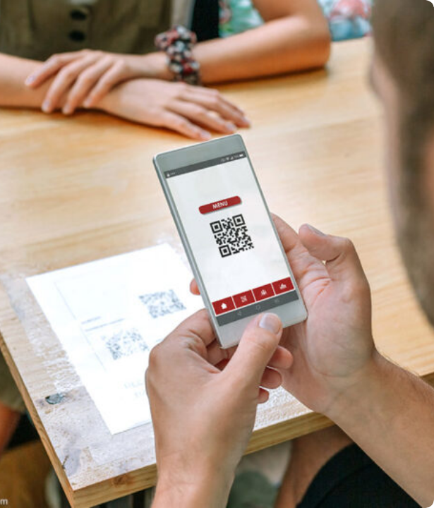
How Guests Browse Has Changed
Paper • Digital • One Scan
Customers search, scan, and browse every day directly from their phones. Your menu should be naturally ready for their expectations.
Instant Access. Zero Friction. Guests simply scan your table QR code to start browsing high-resolution dishes without downloading any external apps.

Slide 4

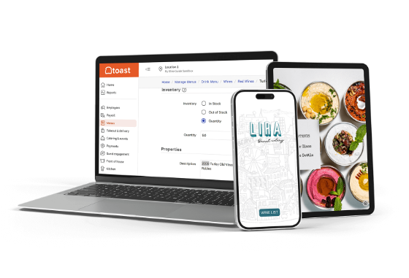
Introducing Horizon Menu
A QR Code Is Just the Door
What happens after the scan is what creates loyalty and higher orders:
•
Instant Mobile Browser Access: Your full menu loads cleanly in under two seconds.
•
No App Downloads: Customers don't need to install anything or sign up for accounts.
•
Rich Dish Presentations: High-resolution photos, clear pricing, and live availability.
•
Tailored to Your Brand: Looks and feels like your business, not a generic spreadsheet.

Slide 5




One Scan. That's It.
02 • OPEN
04 • ORDER
Your branded digital menu opens instantly in their native mobile browser.
They order with your staff or message via your preferred venue method.
01 • SCAN
03 • BROWSE
Customer arrives and scans the custom table QR code using their camera.
They easily explore categories, photos, dietary tags, and detailed pricing.

Slide 6






It's More Than Just a QR Code
Organized Menus
Visual Appeal
Business Identity
Structured categories allow diners to find drinks, mains, and desserts quickly without scrolling fatigue.
High-resolution dish photos remove guesswork, sparking appetites and boosting average order values.
Includes location maps, operational hours, social links, and phone numbers in one clean interface.
Clear Details: Full pricing and ingredient transparency.
Dietary Tags: Veg, non-veg, vegan, and spice indicators.
Custom Branding: Matched to your cafe's colors and fonts.

Slide 7




Your Business. Your Unique Style.
READY TIER
PLUS TIER
CUSTOM TIER
Clean & Fast: Launch within 24 hours using sleek, modern restaurant layouts tailored to quick service and cafes.
Brand Control: Enhanced styling, personalized category layouts, and curated typography that highlights your signature flair.
Built Around You: A bespoke digital menu designed from the ground up to match luxury hotels and flagship bistros.
Includes logo & brand color matching.
Unique visual identity and premier styling.
Distinctive presentation for growing dining spots.

Slide 8


Menu Updates Made Frictionless
Minor Updates Included
Major Updates Handled
Routine business adjustments are handled smoothly without downtime:
Keep your venue fresh as your menu and seasons evolve:
•
Complete seasonal and festival menu redesigns
•
Real-time price adjustments and seasonal rate tweaks
•
Theme and layout structural transformations
•
Adding new seasonal dishes or marking sold-out items
•
Brand color palette and typography refreshes
•
Updating food photographs and detailed item descriptions
•
Comprehensive category and kitchen restructuring
•
Updating venue contact details, phone numbers, and hours

Slide 9
Simple, Transparent Pricing Plans
Package Feature | READY • ₹999 | PLUS • ₹1,299 | CUSTOM • ₹2,599
Design Direction | Ready-made clean template | Enhanced brand styling | Custom design from scratch
Branding & Logo | Standard logo & color match | Custom font & color theme | Full brand immersion & assets
Menu Setup & QR | Print-ready QR + setup | Custom branded table QR | Bespoke tabletop QR designs
Update Allowance | 1 Major + 6 Minor updates | 2 Major + 8 Minor updates | 2 Major + 10 Minor updates
Hosting & Support | 1st Year included | 1st Year included | 1st Year included + priority

Slide 10
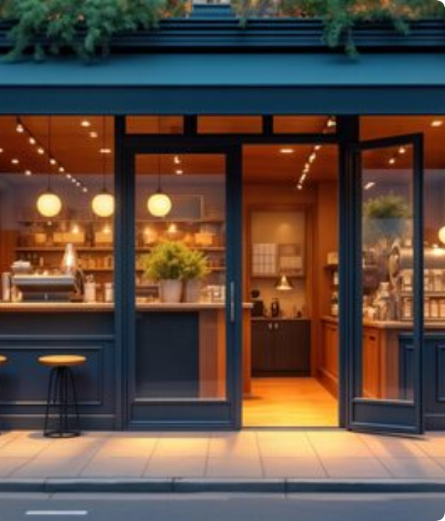
Your Complete Business Online
Horizon Business Website • ₹1,199
Customers don't just look for your menu—they look for your restaurant online before deciding where to eat.
One Link. Your Entire Venue. A dedicated website featuring your story, food gallery, Google Maps directions, operating hours, and direct WhatsApp contact.

Slide 11



The Horizon Roadmap & Future
NEXT • WhatsApp Ordering
Coming soon: Customers browse items, build carts, and send orders straight via WhatsApp.
TODAY • Digital Menu
BEYOND • Digital Suite
Instant table QR menu, zero app installs, live updates, and clear dish photos.
Smart feedback tools, promotional banners, and customer loyalty touchpoints.

Slide 12

Your Customers Are Digital
Is Your Restaurant Ready?
86%
Over 86% of diners comfortably scan QR codes, and 78% check a restaurant's menu on their phone before visiting. Traditional paper alone leaves guests waiting and costs you money every time prices adjust.
Menu → Website → Direct Ordering. Take the first simple step today to modernize your venue's guest experience without complex technical overhead.
Smartphone Users Scan QRs

Slide 13
How We Work With You
01 • CHOOSE: Select your preferred tier (Ready, Plus, or Custom) and any add-ons.
02 • SHARE: Send over your menu list, item prices, food photos, and venue logo.
03 • BUILD: Our team formats, designs, and organizes your mobile digital menu.
04 • REVIEW: Test the private live link on your phone and approve all details.
05 • GO LIVE: Receive print-ready table QR codes and begin welcoming diners.

Slide 14

Ready to Go Digital?
Let's put your menu one scan away.
Digital Menus • Custom Websites • Modern Hospitality Tools

